Slide 1
Java - Exceptions
An exception is a problem that arises during the execution of a program.
The exception is an abnormal condition
exception is an event that disrupts the normal flow of the program
Checked exceptions - Checked exceptions are checked at compile-time
e.g. IOException, SQLException etc.
Runtime exceptions - Unchecked exceptions are not checked at compile time rather they are checked at runtime.
e.g. ArithmeticException, NullPointerException, ArrayIndexOutOfBoundsException etc.
Errors:
e.g. OutOfMemoryError etc
Notes:
File name wrong => checked Exception
Null pointer(logical error) => unchecked Exception
No read permission => Error

Slide 2
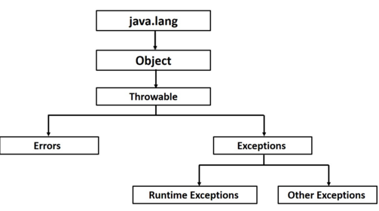
Java-Exceptions

Slide 3
Try Catch
try block is used to enclose the code that might throw an exception.
It must be used within the method.
Java try block must be followed by either catch or finally block
Eg:
try{
…..
}
catch(Exception e)
{
….
}
Notes:
DataExceptionMapper implement ExceptionMapper

Slide 4
Finally
Java finally block is a block that is used to execute important code such as closing connection, stream etc.
Java finally block is always executed whether exception is handled or not.
Java finally block must be followed by try or catch block.
E.g:
try{
…..
} catch(Exception e){
…..
} finally {
…..
}

Slide 5
Throw
The Java throw keyword is used to explicitly throw an exception.
can throw either checked or uncheked exception in java by throw keyword. The throw keyword is mainly used to throw custom exception.
Syntax:
throw exception;

Slide 6
Example
public class TestThrow
{
static void validate(int age){
if(age<18) throw new ArithmeticException("not valid");
else System.out.println("welcome to vote");
}
public static void main(String args[]){
try{
validate(13);
} catch(ArithmeticException e) {
System.out.println(”error :”+e);
}
System.out.println("rest of the code...");
}
}

Slide 7
Throws
The Java throws keyword is used to declare an exception.
If a method does not handle a checked exception, the method must declare it using the throws keyword.
Syntax:
void check() throws exception_class_name {
//method code
}

Slide 8
Example
import java.io.IOException;
class Testthrows
{
void check() throws IOException{
throw new IOException("device error");//checked exception
}
void n() throws IOException{
check();
}
void p(){
try{ n(); }
catch(Exception e){System.out.println("exception handled");}
}

Slide 9
User defined Exception
class WrongInputException extends Exception {
WrongInputException(String s) {
super(s);
}
}
class Input {
void method() throws WrongInputException {
throw new WrongInputException("Wrong input");
}
}

Slide 10
User defined Exception
class TestInput {
public static void main(String[] args){
try {
new Input().method();
}
catch(WrongInputException wie) {
System.out.println(wie.getMessage());
}
}
}

Slide 11
Class Exercises
Exercises

